Slide 1
Data types in Java

Slide 2
Why
Different sizes and values that can be stored in the variable. Because of that we need to tell JVM to how much space you required to store data
In java
You need to define data type when you declare variable.
Once you defined you cannot change it.

Slide 3
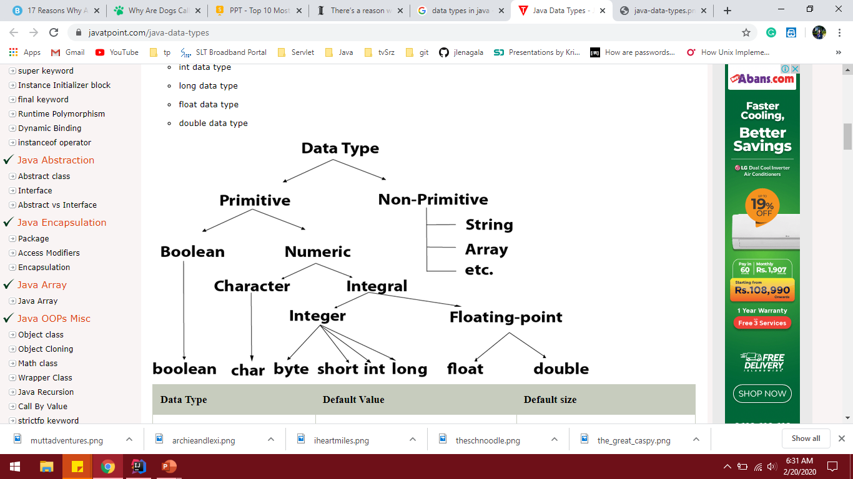
Data Types
Primitive – hold the values what you assigned
Non – Primitive
-Hold the memory references

Slide 4
Boolean
store only two possible values:
true
false

Slide 5
Char
Single 16-bit Unicode character
Byte
8-bit signed two’s complement integer
Minimum value is -128
Maximum value is 127
Its default value is 0.
Saves space because a byte is 4 times smaller than an integer.
Short
16-bit signed two’s complement integer

Slide 6
Int
It is a 32-bit signed two’s complement integer.
Minimum value is 2^31-1
Maximum value is -2^31
Its default value is 0.
Long
The long data type is a 64-bit two’s complement integer.

Slide 7
Float
float data type is a single-precision 32-bit
Double
float data type is a single-precision 64-bit
float and double data types were designed specially for scientific calculations

Slide 8
Reference Data Types
Contains a memory address of variable value.
A primitive type has always a value, while non-primitive types can be null.
Types
String
Array

Slide 9
Strings
Contains a collection of characters
Many inbuilt methods available.
toLowerCase()
toUpperCase()
Length()
Immutable –Not allowed to change
Array
used to store multiple values in a single variable
cannot re size once created

